Slide 1
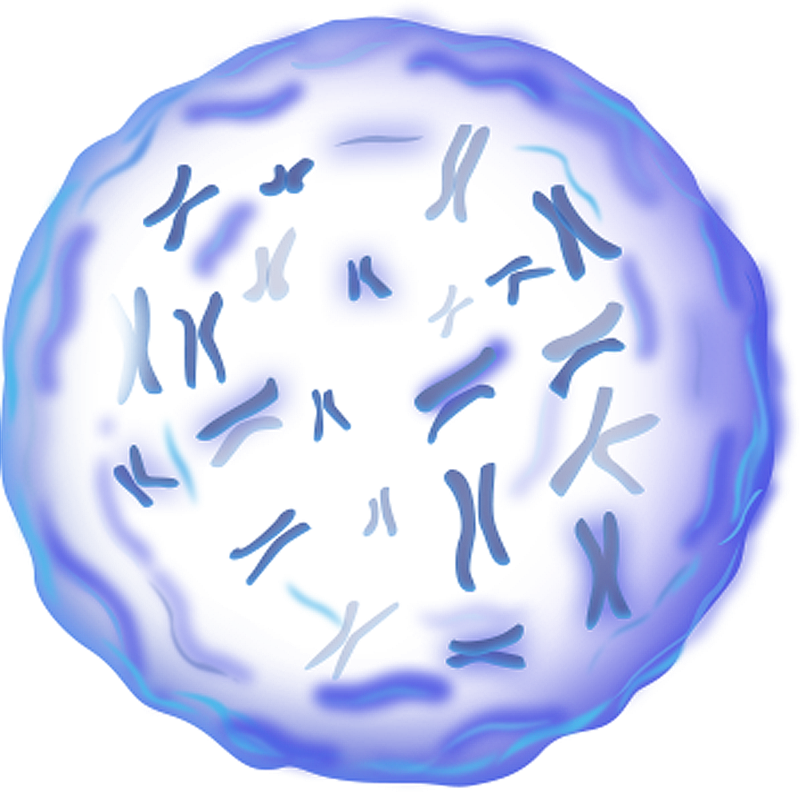
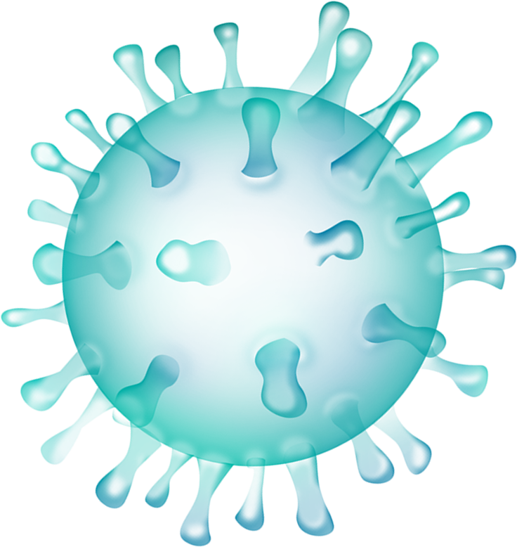

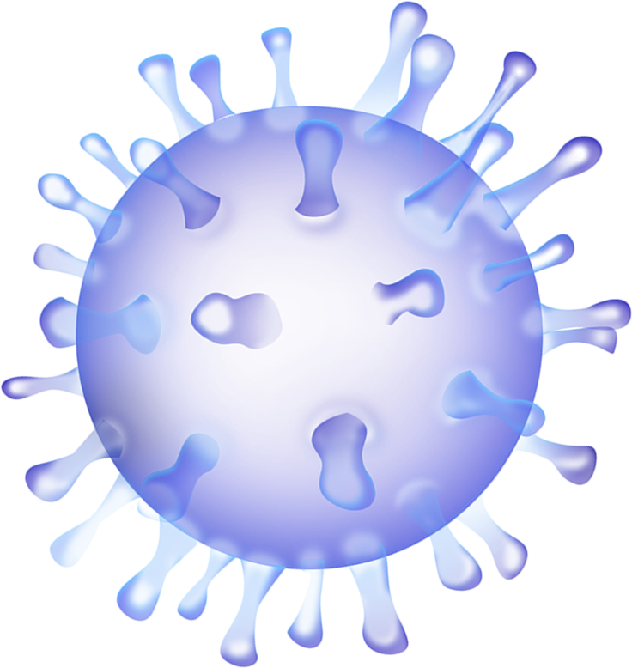

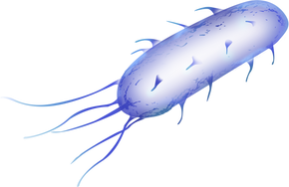
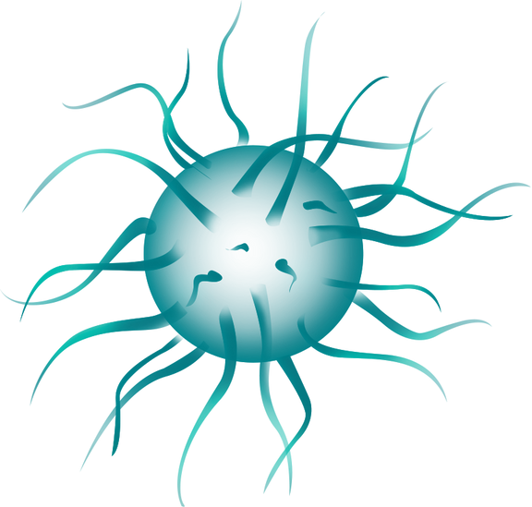
CLASS
CLOSTRIDIA
By Kizzie Mae Dacanay

Slide 2

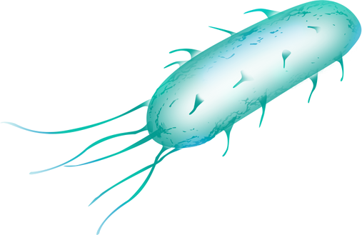
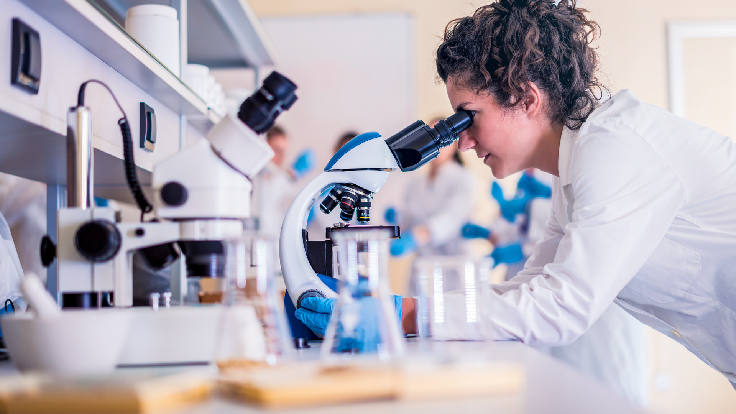
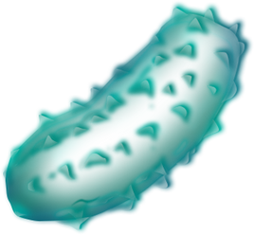
Overview of Anaerobic Bacteria
Bacteria are microscopic, single-celled organisms. There are thousands of different kinds, and they live in every conceivable environment all over the world.
They live in soil, seawater, and deep within the earth’s crust. Some bacteria have been reported to live in radioactive waste.

Slide 3
Overview of Anaerobic Bacteria
Only a few kinds of bacteria always cause disease when present. They are called pathogens.
Bacteria can be classified in several different ways. One way is based on whether they need oxygen to live and grow:
Aerobic bacteria: Need oxygen
Anaerobic bacteria: Have trouble living or growing when oxygen is present
Facultative bacteria: Can live and grow with or without oxygen

Slide 4
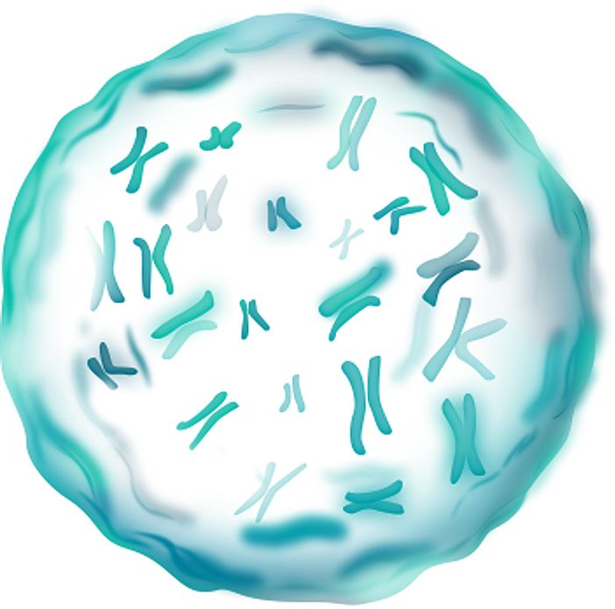


General Characteristics
A group of gram-positive, anaerobic bacteria.
Found in soil, intestines, and organic matter.
Known for their ability to form spores and produce potent toxins.

Slide 5
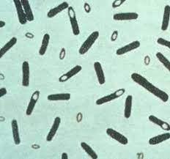
Morphological Features
Rod-shaped, gram-positive bacteria (may lose stain with age).
Form endospores resistant to heat, desiccation, and chemicals.
Pleomorphic appearance in some species.

Slide 6


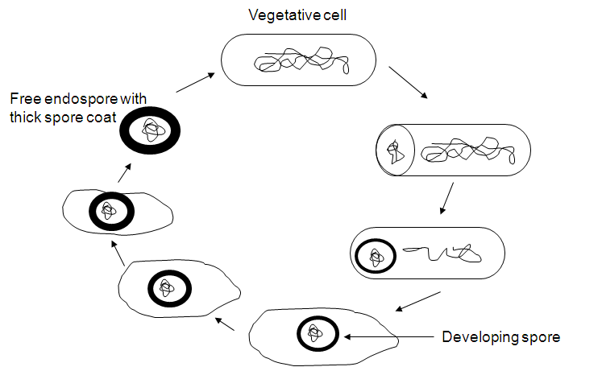
SPORULATION IN CLOSTRIDIUM

Slide 7
LIFE CYCLE:
difficile exists in two states—the vegetative (growth) form or the spore state.
In the vegetative state, the bacterium is able to use nutrients to grow and divide. However, when conditions become unfavourable, C. difficile is able to enter a dormant state and form a highly resistant spore.
Unfavorable conditions include deprivation of nutrients, exposure to a very acidic environment, or exposure to high temperatures.
These spores are very resistant to heat, radiation, drying, chemicals, and even oxygen (for up to two years).

Slide 8
LIFE CYCLE:
The spore is dormant, and a thick spore coat protects its genetic material.
When conditions become favourable again, the C. difficile spore is able to return to its vegetative state.
The bacteria’s ability to form spores enables its survival through the human digestive system.
In addition to out into the oxygenated environment until it returns to its human host and back into the vegetative state.

Slide 9
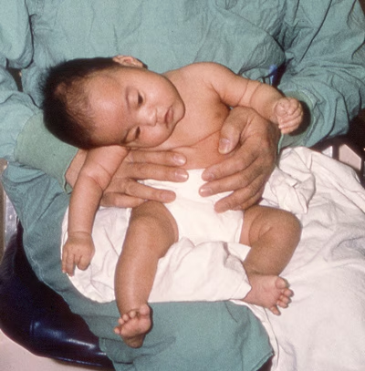
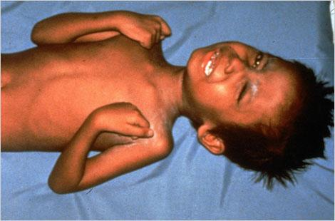
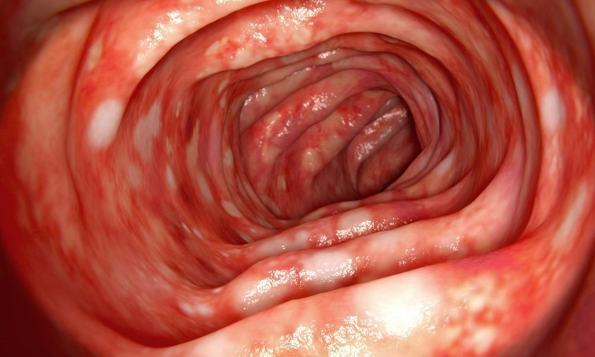
Host associated species
C. botulinum
C. tetani
C. difficile
Causes botulism, a serious form of food poisoning due to toxin production.
Causes tetanus, leading to muscle stiffness and spasms.
Can cause severe diarrhea and colitis, often in hospitalized patients after antibiotic treatment.

Slide 10
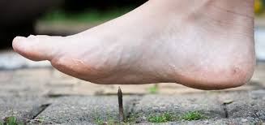
Route of Infection:
Spores typically enter the body through wounds, especially deep punctures or cuts contaminated with soil or feces.
The anaerobic environment of the wound allows the spores to germinate and multiply.
Types of Tetanus:
Generalized (most common): Affects the whole body.
Localized: Limited to muscles near the infection site.
Neonatal: Occurs in newborns, often due to infection of the umbilical stump.
C. tetani

Slide 11
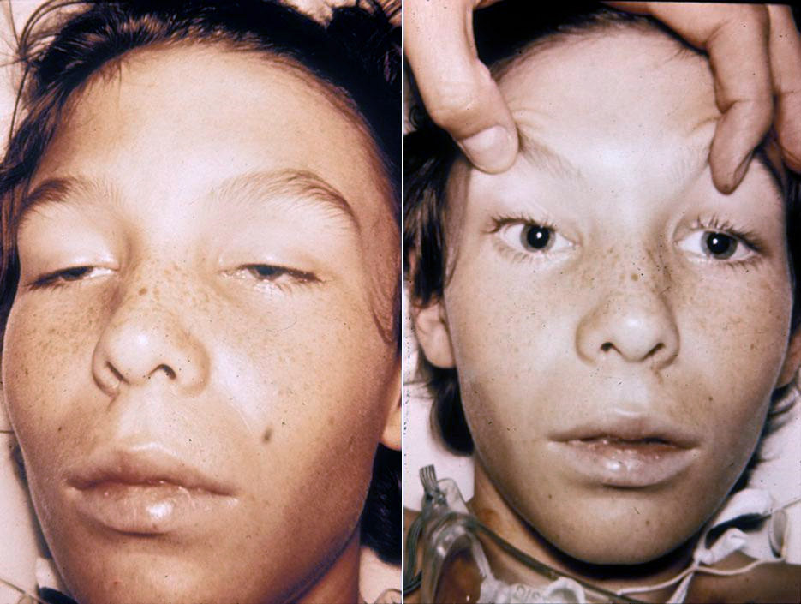
Botulism is a rare but serious illness.
It is caused by a toxin that attacks the body's nerves and causes difficulty breathing, muscle paralysis, and even death.
Foodborne Botulism: Caused by ingesting foods contaminated with preformed toxin (e.g., improperly canned or preserved foods).
Infant Botulism: Occurs when spores are ingested, germinate, and produce toxin in the infant's intestine (often linked to honey).
Wound Botulism: Arises when spores infect a wound and produce toxin under anaerobic conditions.
C. botulinum

Slide 12
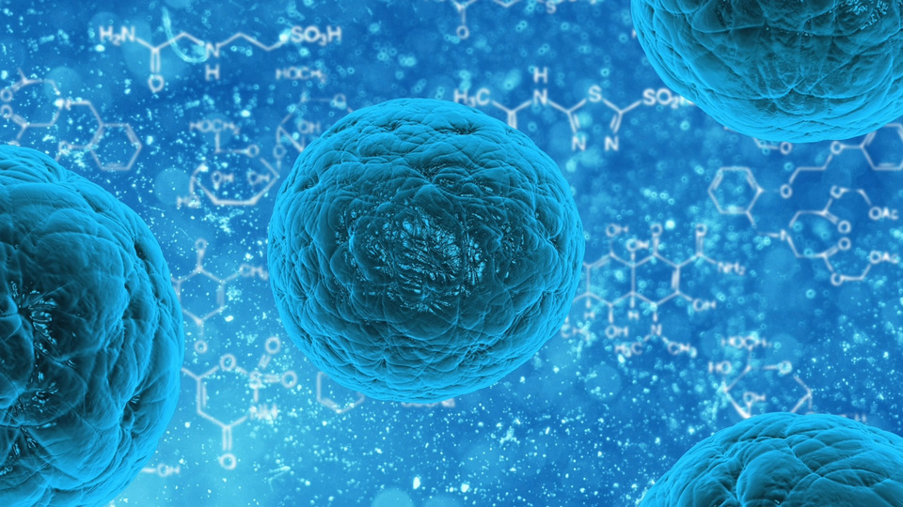
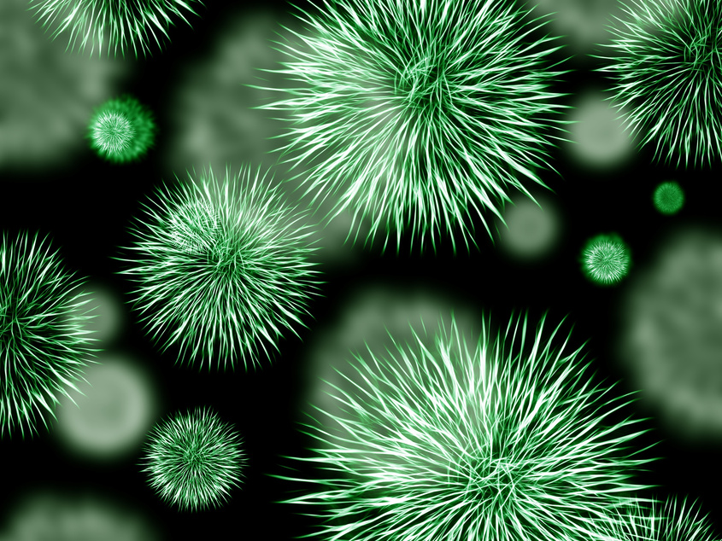
Industrial Applications
certain Pharmaceuticals
Solvents

Slide 13
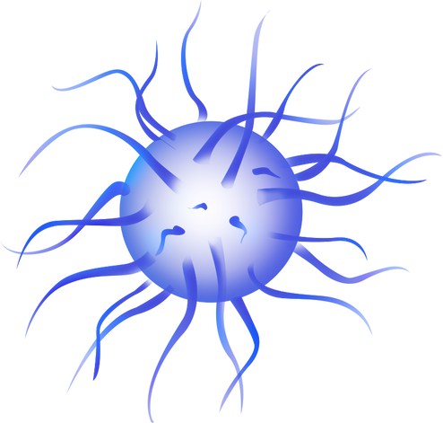
THANK YOU

